Slide 1

The Last Capture
Presentation 1
Team: Yibai Zhang & Vasco Pauthier

Slide 2

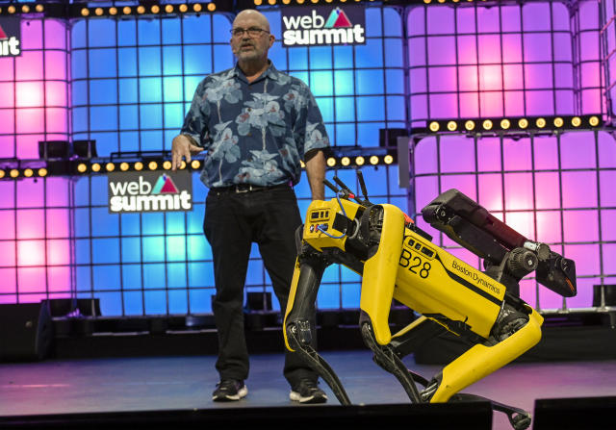
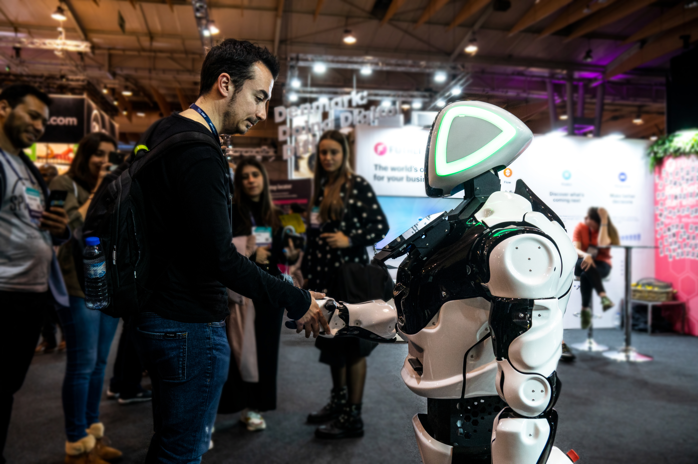
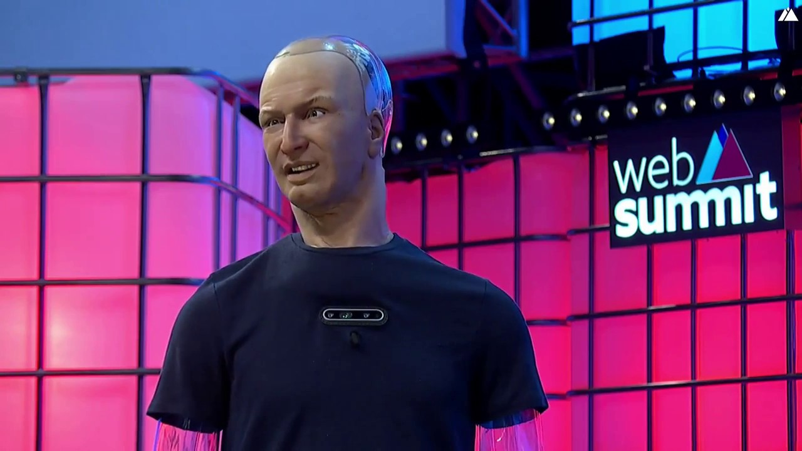
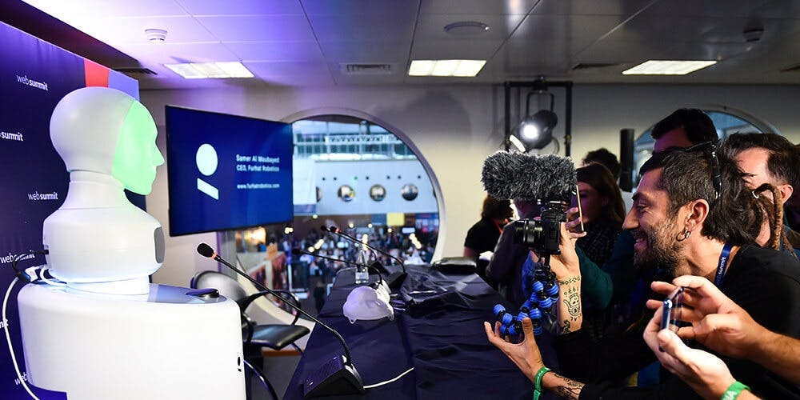
Client – Web Summit
Web Summit is an annual technology conference held in Lisbon, Portugal, considered the largest tech event in the world.

Slide 3
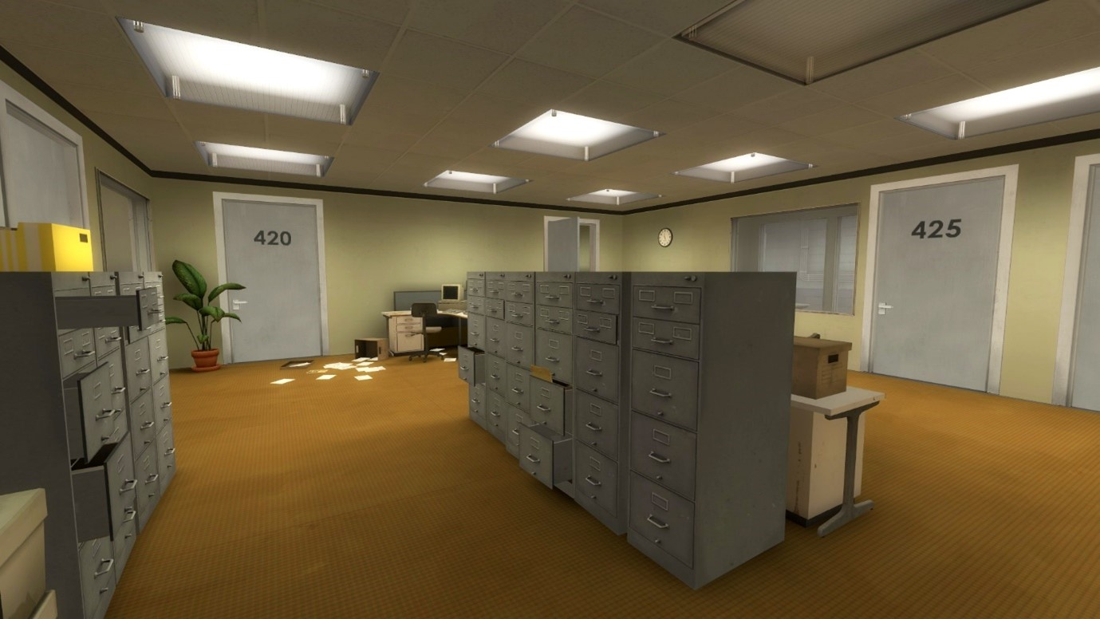
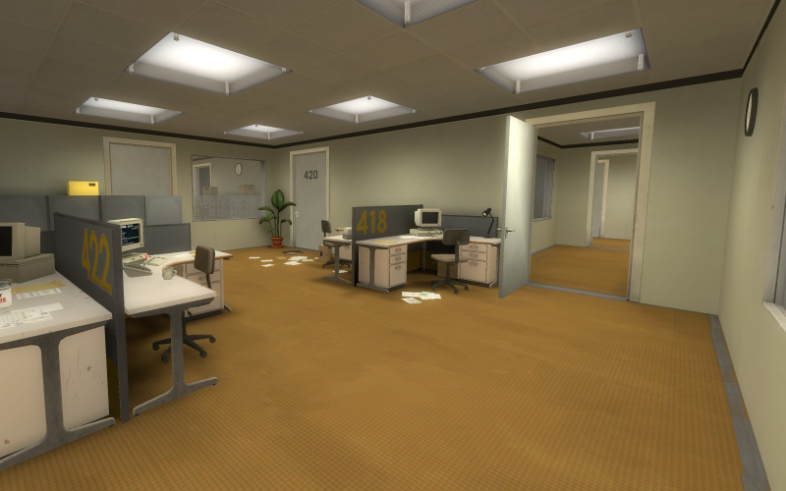
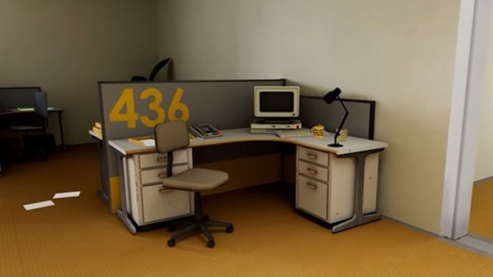
Project Visual Research
The Stanley Parable

Slide 4
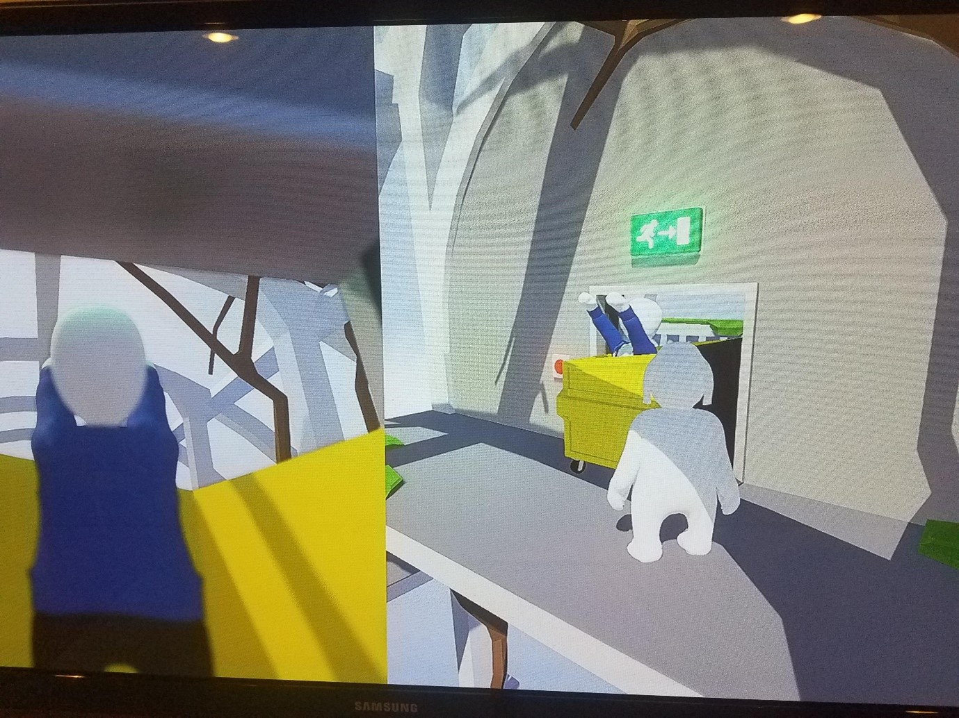
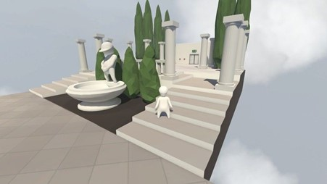
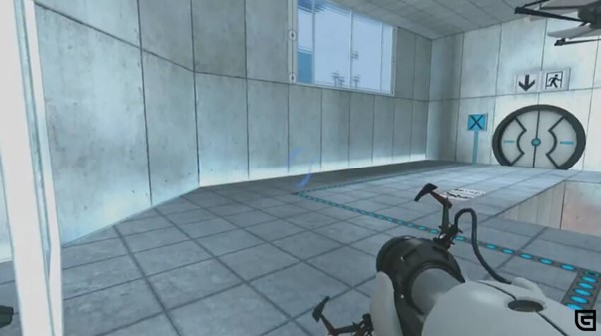
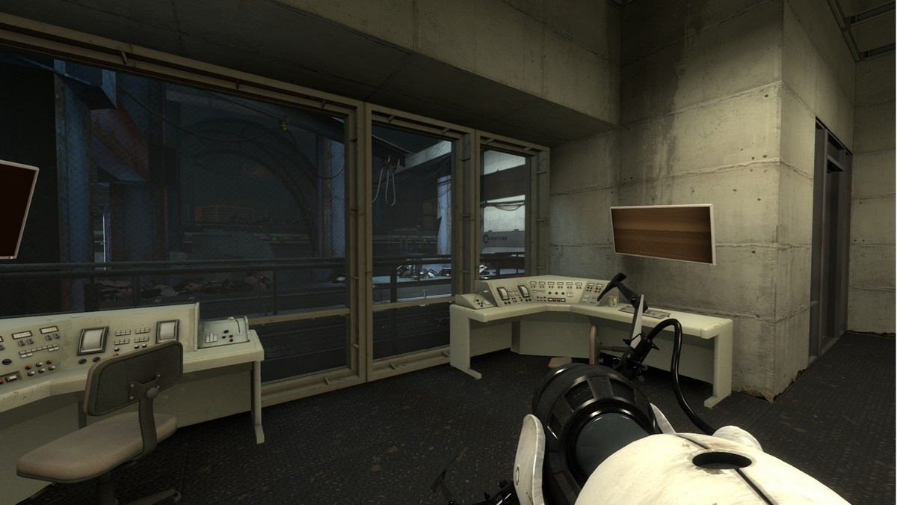
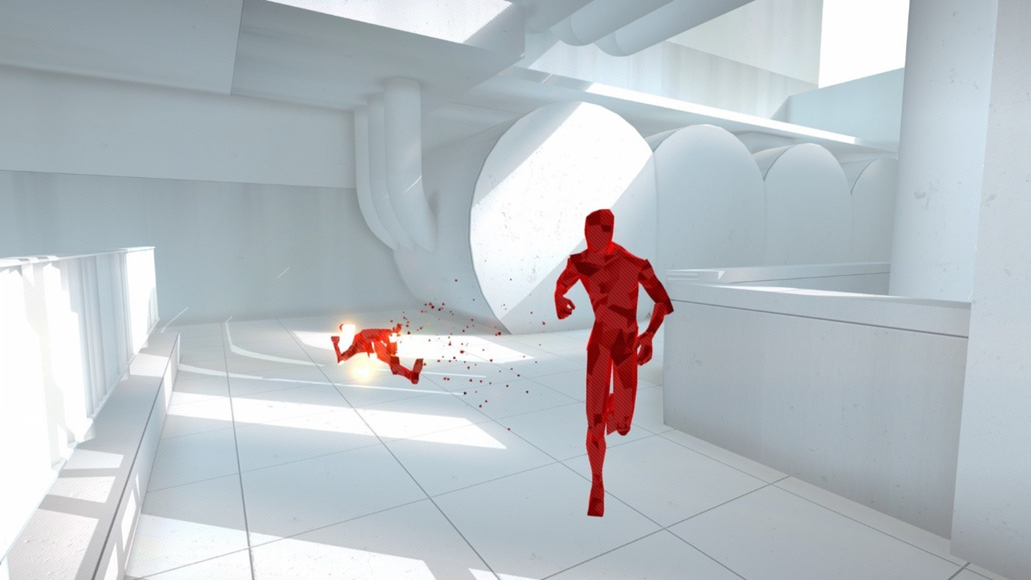
Human Fall Flat
Portal
Superhot

Slide 5
Story
Character
Reporter (main character, player control)
Newly developed AI Robot Prototype (enemy, chaser, malfunction ---> friend, protector)
A reporter is late for the web summit convention. He needs to solve puzzles as fast as possible and so he can get to the convention. During his attempt at escape, he will be confronted to an evil robot.

Slide 6
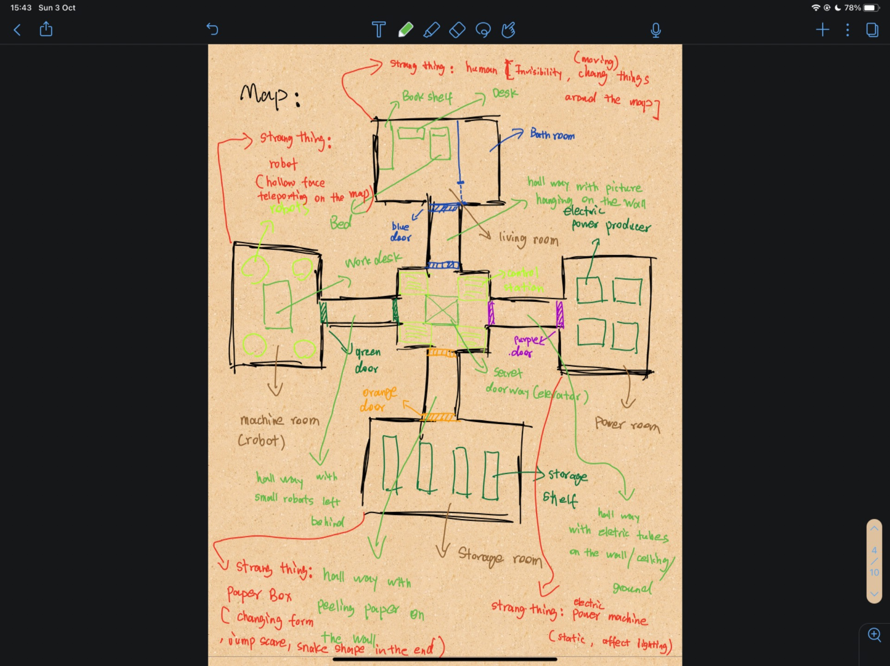
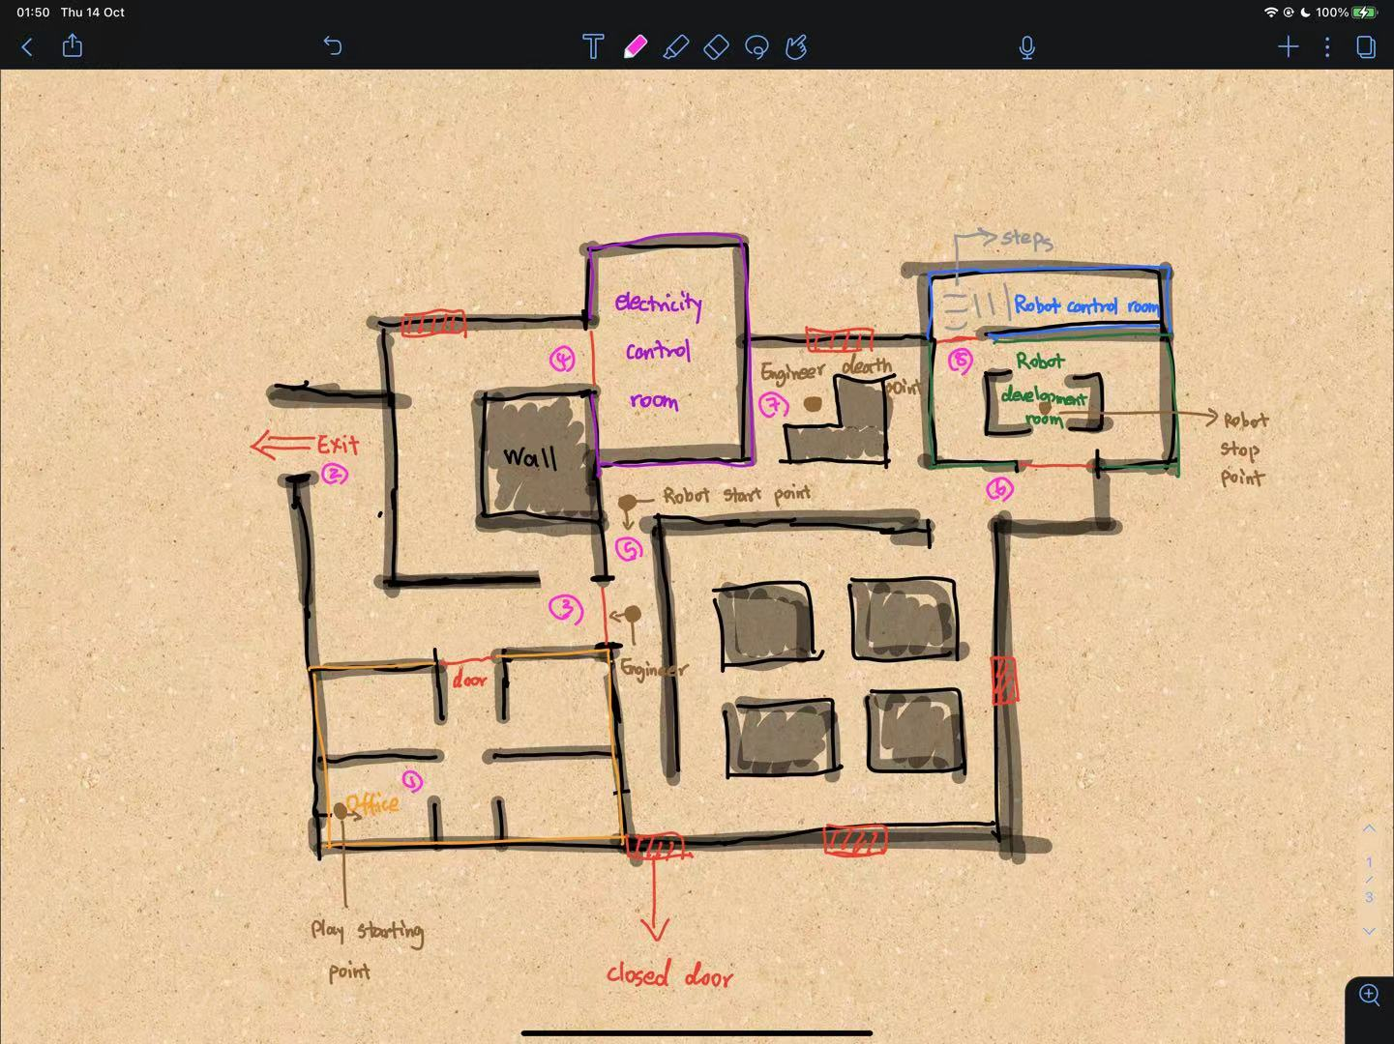
Map Sketch Idea 1 & 2

Slide 7
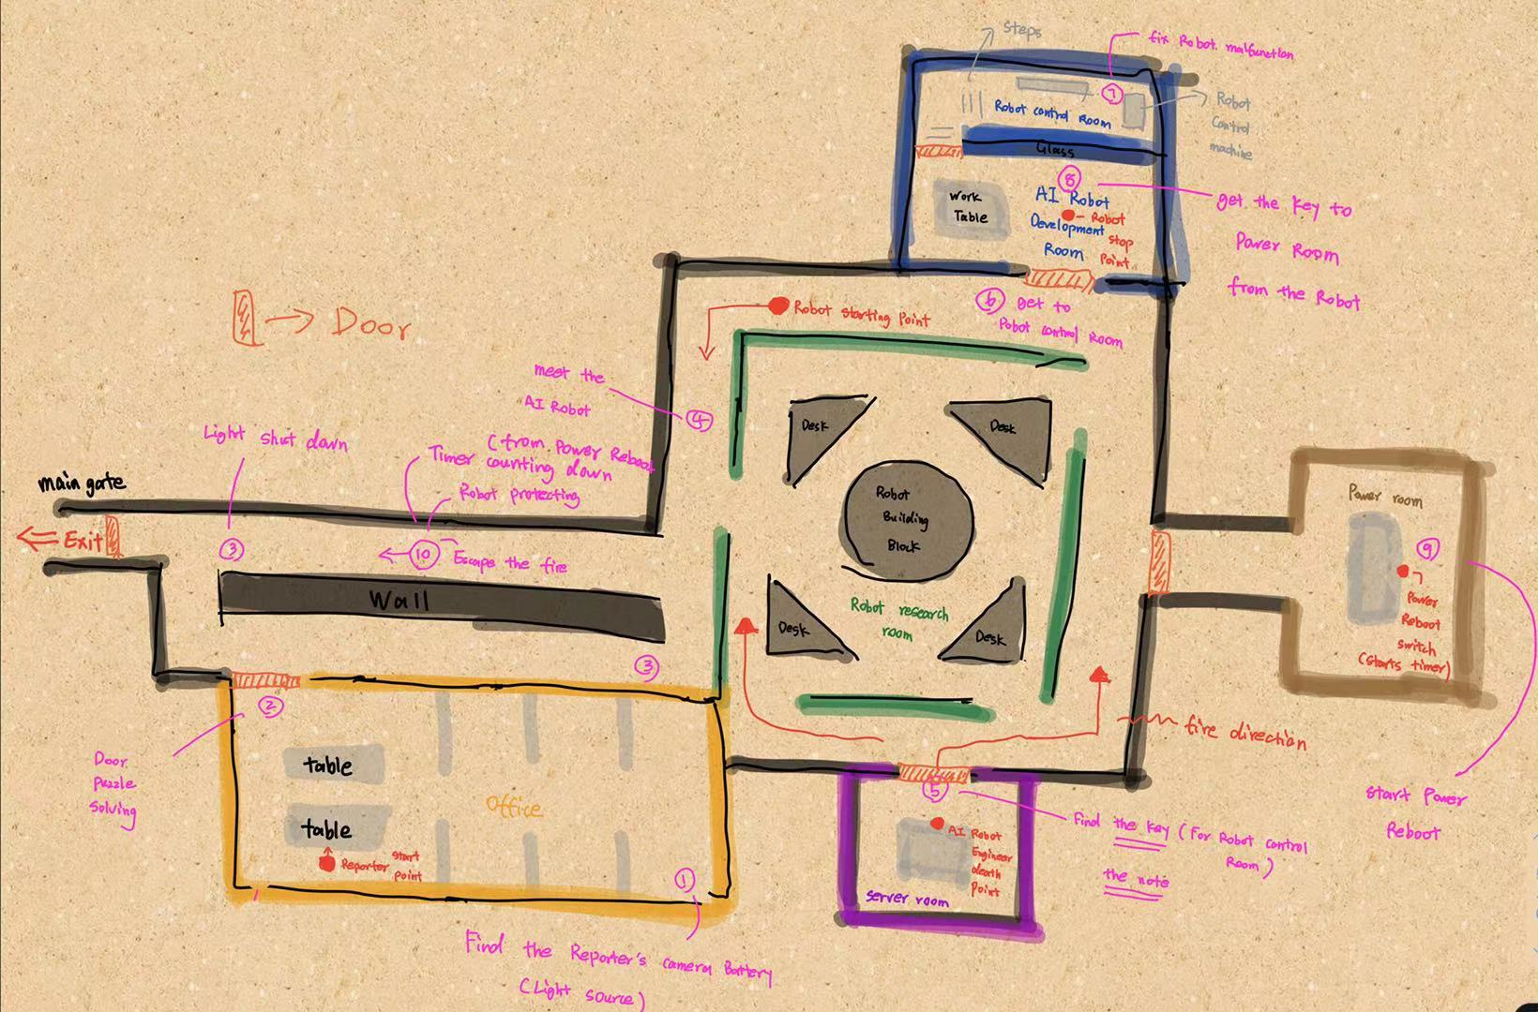
Map Layout
Main Actions & Events
Find battery for camera.
Unlock office door.
Light shut down near main gate.
Robot chasing.
Meet the engineer corpse.
Get the overwrite circuit. &
read the note from the engineer.
Overwrite the robot in its control room.
The robot smashes the power room door.
Use the power reboot switch.
Reboot timer starts.
Fire start to spread.
Escape from the fire to main gate.
Robot protect the reporter.
Reboot end & the reporter escape through the main gate.

Slide 8
Story Meaning
Robot will become highly intelligent in the future.
Robot can be both dangerous and protective.
Technology is progressing fast.

Slide 9
Game Genres
Puzzle
Escape
Thriller

Slide 10
Gameplay Mechanics
Search & find – the battery, rooms, etc…
Puzzle solving, use the right combination to unlock door, note reading, etc…
Robot chasing, fire spreading, player escape, electrocuted and burned on touch.

Slide 11
Thanks for watching!

